Slide 1
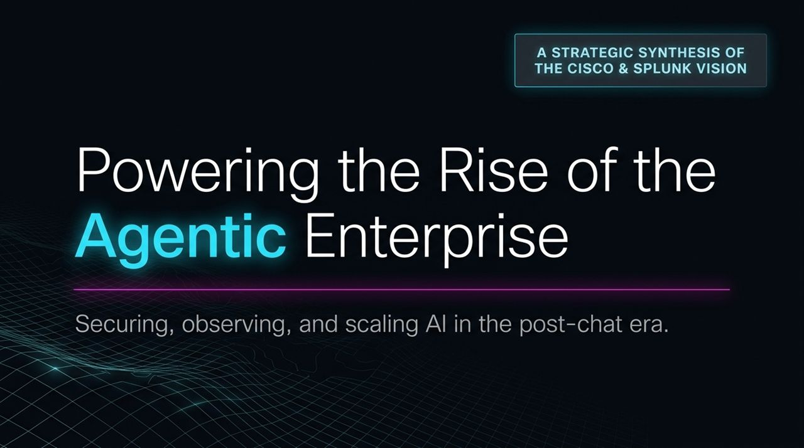
Notes:
Welcome & Setting the Stage: Good morning/afternoon, everyone. Today, we’re unpacking a massive paradigm shift in enterprise technology—the transition to the Agentic Enterprise.
The Core Thesis: As Cisco and Splunk come together, our combined vision centers on one imperative: how to secure, observe, and scale AI in what we call the "post-chat era".
Beyond the Chatbox: For the past few years, the narrative around AI has been dominated by prompt boxes and single-turn conversational chatbots. But that was just phase one. We are entering a world where autonomous digital actors operate continuously across our networks and systems.
The Goal of this Session: Over the next hour, we’ll explore what this shift means for your compute infrastructure, network capacity, security operations, and overall data strategy.
https://www.youtube.com/watch?v=-N6eBiOtPaM

Slide 2
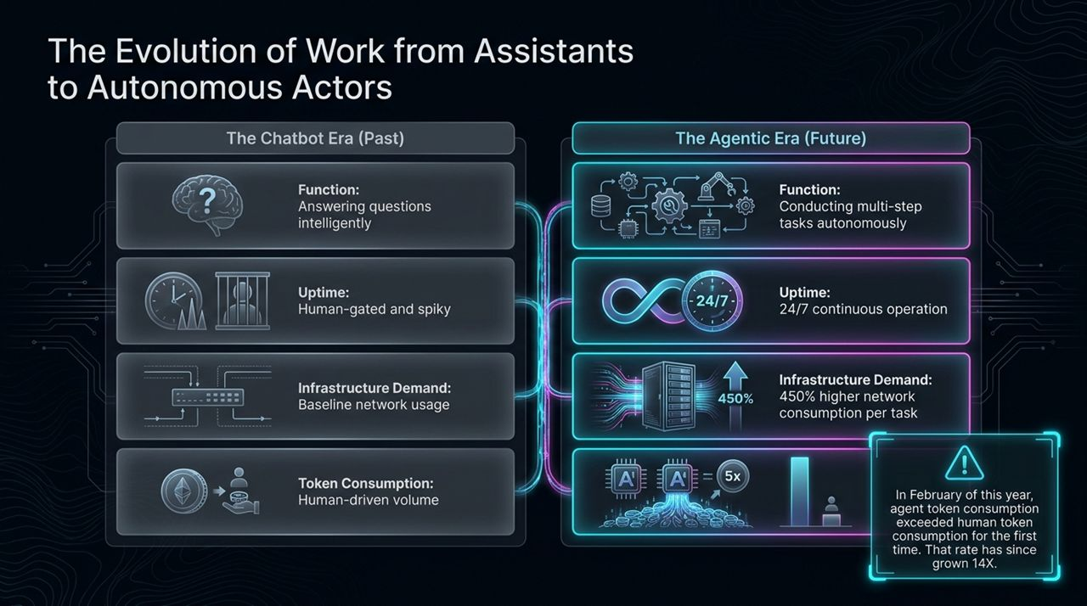
Notes:
Chatbots vs. Autonomous Agents: Let's contrast where we were with where we're going.
In the Chatbot Era, AI acted like a reactive digital assistant. You asked a question, it gave an answer. Usage was human-gated, meaning network traffic spiked only when humans were at their keyboards typing prompts.
In the Agentic Era, AI becomes an autonomous digital coworker. Agents perform complex, multi-step workflows across systems without human intervention at every step.
The Operational Impact:
24/7 Operations: Agents don't sleep or take lunch breaks. They run continuously in the background.
The 450% Surge: Performing a task autonomously requires an average of 450% higher network consumption per task compared to a human typing a query.
The Tipping Point: Earlier this year, we crossed a historic threshold: agent token consumption officially surpassed human token consumption globally—and that rate has since accelerated 14X.
Takeaway: Your networks and data centers weren't originally architected for continuous, machine-driven, high-bandwidth interaction.

Slide 3
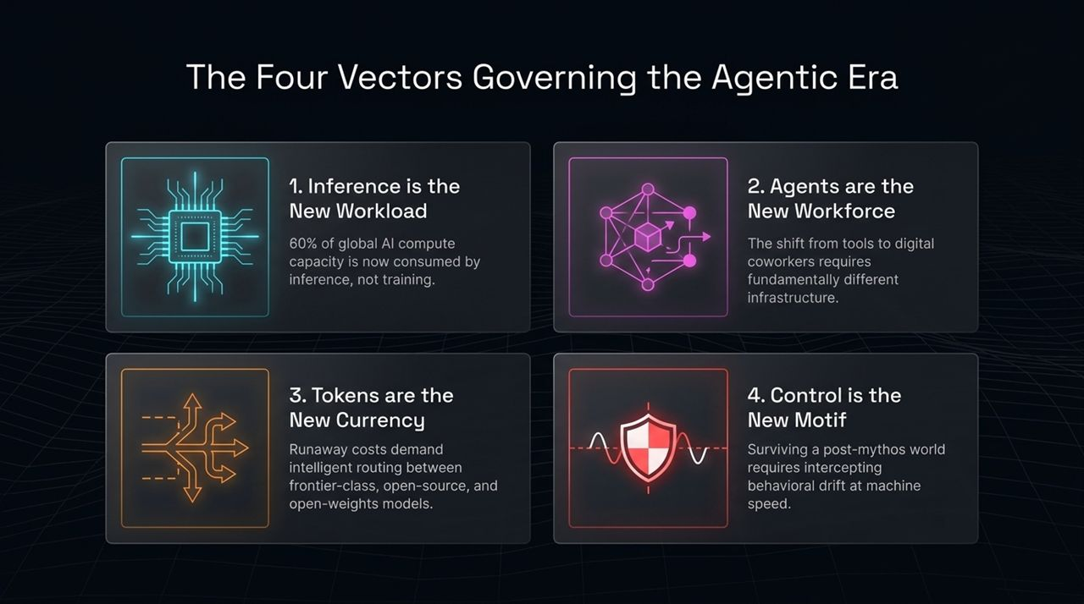
Notes:
Navigating the New Landscape: Four critical shifts—or vectors—are redefining enterprise IT strategies right now:
Inference is the New Workload: The days of focus being entirely on LLM training are over. Today, 60% of global AI compute capacity is spent on inference. Enterprise value is created when models are running, not just when they are being trained.
Agents are the New Workforce: Moving from static tools to active digital teammates means existing identity access management (IAM) and network structures must treat agents as distinct operational entities.
Tokens are the New Currency: High-end frontier models (like GPT-4o or Claude 3.5 Sonnet) are expensive. Unchecked agent loops can create runaway token costs in minutes. Smart routing between frontier, open-source, and open-weight models is now mandatory for cost efficiency.
Control is the New Motif: We must move beyond the hype ("mythos") of AI and focus on practical guardrails. Because agents execute actions across systems, we must intercept behavioral drift at machine speed.

Slide 4
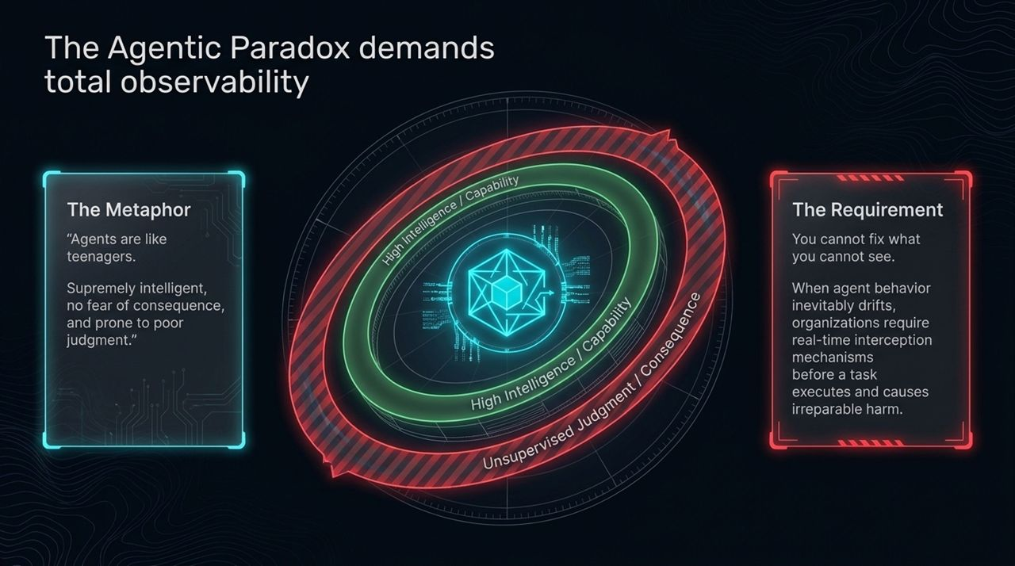
Notes:
The "Teenager" Metaphor: To understand why managing AI agents is tricky, consider this analogy: "Agents are like teenagers—supremely intelligent, zero fear of consequences, and prone to occasional poor judgment."
High Capability vs. High Risk: An agent might have the capability to query a database, compile an executive summary, and send an email. But without strict guardrails, it might accidentally pull confidential M&A data or email an unverified external address.
The Requirement: You cannot fix or secure what you cannot see.
Real-Time Interception: Traditional post-hoc log auditing isn't enough. When an agent’s behavior drifts off track, organizations need real-time interception mechanisms to flag and halt the task before execution causes irreversible damage. Total observability is non-negotiable.

Slide 5
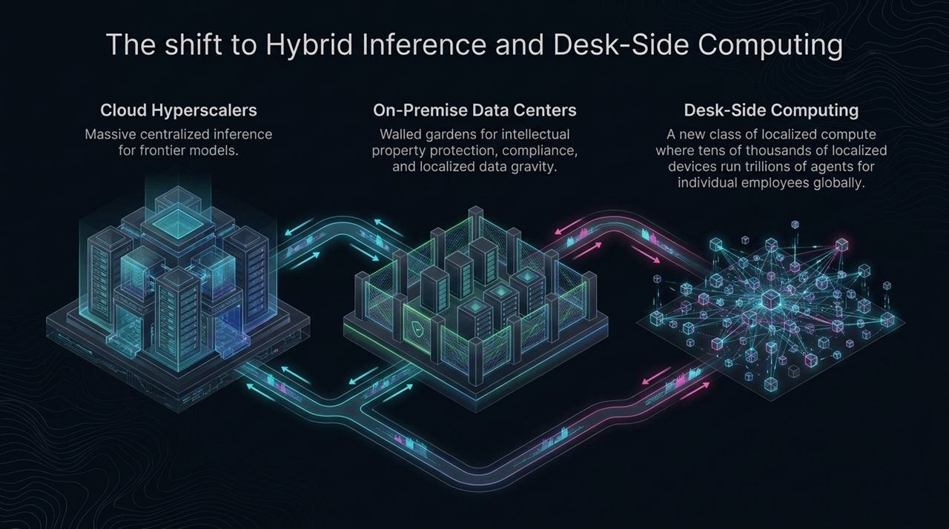
Notes:
Where Does the Compute Live? The compute architecture for AI is decentralizing across three key tiers:
Cloud Hyperscalers: Ideal for massive centralized inference, running heavy frontier models, and processing massive public data sets.
On-Premise Data Centers: Essential for protected intellectual property, regulatory compliance, and localized data gravity where cloud transfer is prohibited or too latency-sensitive.
Desk-Side Computing (Edge AI): A major emerging paradigm. In the near future, tens of thousands of localized devices, laptops, and workstation chips will run localized, smaller models powering trillions of daily micro-tasks directly at the user level.
Architectural Challenge: Security, observability, and networking fabrics must span seamlessly across all three domains without creating siloed blind spots.

Slide 6
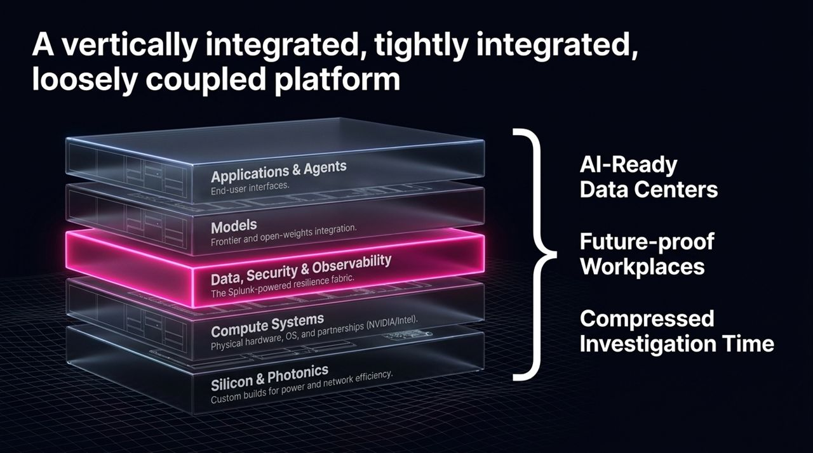
Notes:
The Full-Stack Solution: To power the Agentic Enterprise, Cisco and Splunk are delivering a stack that is vertically integrated, tightly integrated, yet loosely coupled.
Walking Through the Layer Cake:
Silicon & Photonics: Building high-density, power-efficient, network-optimized custom chips.
Compute Systems: Partnering deeply with NVIDIA, Intel, and hardware leaders to optimize system-level performance.
Data, Security & Observability (The Core Focus): The Splunk-powered resilience fabric sitting directly in the middle. It handles trace monitoring, anomaly detection, and identity verification across every layer.
Models: Seamless integration across both frontier (closed) and open-weights/open-source model architectures.
Applications & Agents: The top-layer user interfaces where autonomous workflows run.
Why This Matters: Optimizing just one layer isn't enough; true performance and security require co-design from silicon all the way up to the agent application layer.

Slide 7
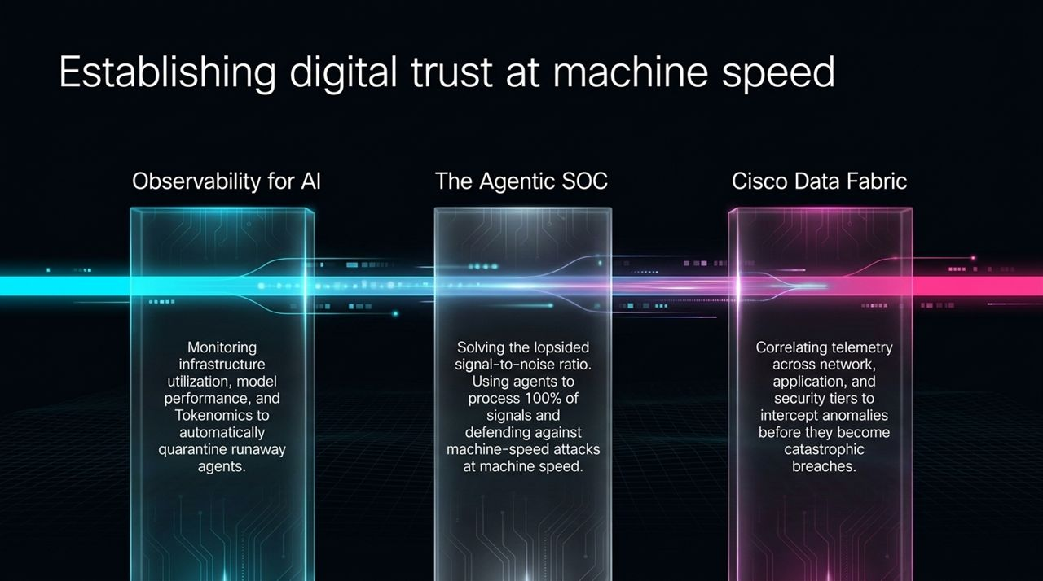
Notes:
Pillars of Digital Trust: How do we practically operationalize security and efficiency in this new era?
Observability for AI: Tracking infrastructure usage, latency, model drift, and token economics. If an agent enters an infinite retry loop, automated systems immediately quarantine it before it runs up a massive bill or floods the network.
The Agentic SOC: Security operations centers are severely overwhelmed by signal volume. We are flipping the script by deploying specialized security agents to process 100% of telemetry signals autonomously, allowing defenders to respond to machine-speed threats in real time.
Cisco Data Fabric: Correlating telemetry across the network, application, and security domains to spot subtle anomalies before they manifest as catastrophic data breaches.

Slide 8
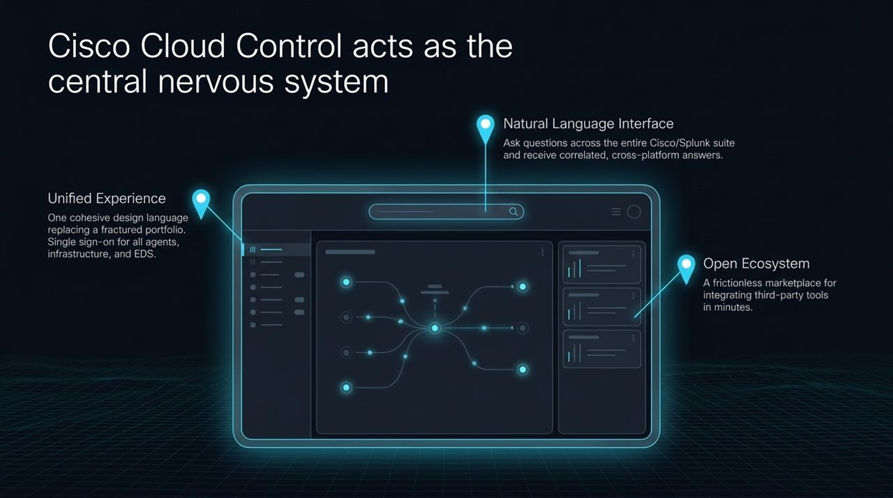
Notes:
Unified Operations: Managing complex infrastructure requires a streamlined operational console. Cisco Cloud Control acts as the central nervous system across the combined portfolio.
Key Components:
Unified Experience: Replaces fragmented management tools with a single design language and single sign-on (SSO) for managing agents, networks, and enterprise data fabrics.
Natural Language Interface: Operators don't need to write complex cross-platform queries manually. You can ask plain-language questions across the Cisco and Splunk portfolio to receive instantly correlated answers.
Open Ecosystem: Built with open APIs and a marketplace model so third-party security and IT tools can integrate seamlessly in minutes.

Slide 9
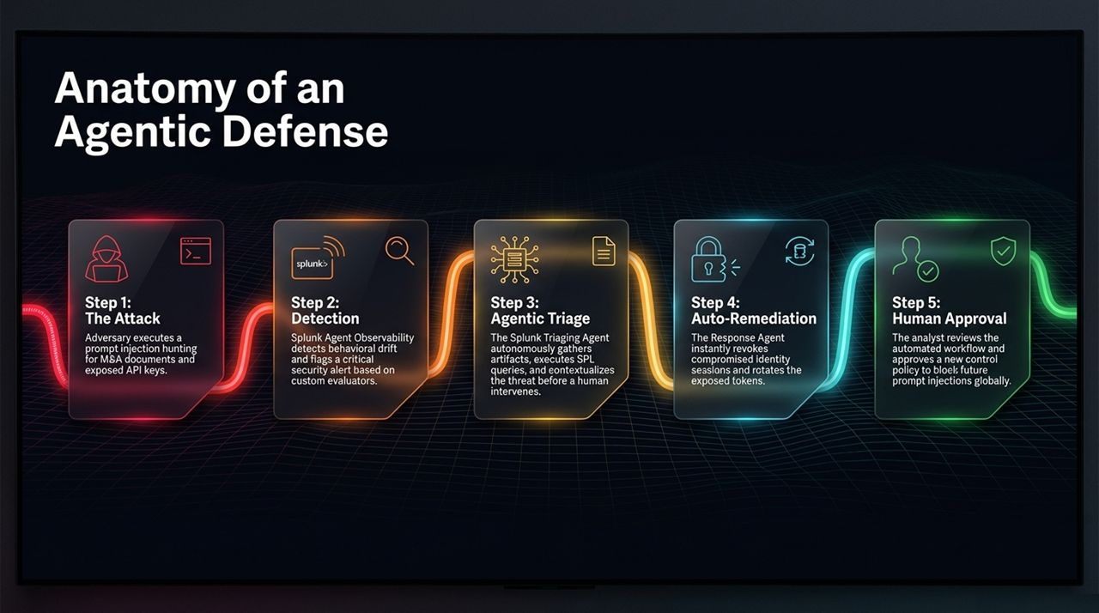
Notes:
Walking Through a Real-World Scenario: Let's break down how an agentic defense stops a machine-speed attack in 5 distinct steps:
Step 1: The Attack: An adversary uses an indirect prompt injection attack on a corporate agent, trying to trick it into dumping sensitive Master Services Agreements (MSAs) and API keys.
Step 2: Detection: Splunk Agent Observability monitors the execution trace in real time, flags the abnormal behavioral drift, and triggers a high-severity alert.
Step 3: Agentic Triage: Before human analysts even open the ticket, a Splunk Triaging Agent gathers technical artifacts, runs SPL log queries, and contextualizes the incident scope automatically.
Step 4: Auto-Remediation: A dedicated Response Agent takes immediate action: revoking compromised identity tokens and rotating leaked API keys instantly.
Step 5: Human Approval: The human analyst steps in at the decision gate, reviews the remediation steps, and approves a global policy rule to permanently prevent similar prompt injection patterns across the organization.

Slide 10
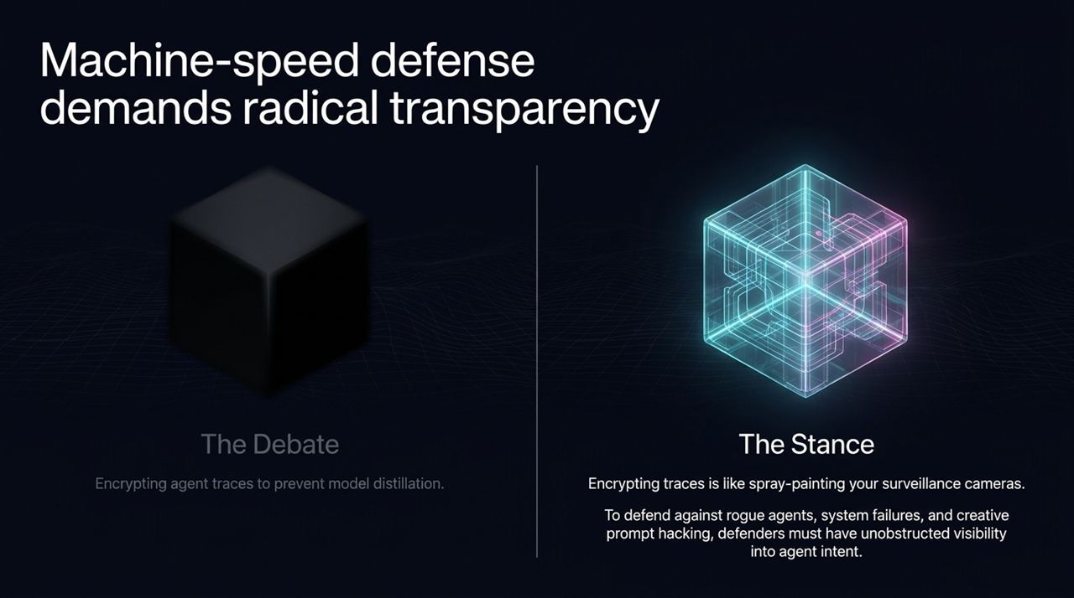
Notes:
Industry Controversy: There is currently a industry debate around whether enterprises should encrypt agent traces end-to-end to prevent competitors or model providers from distilling their models.
Our Stance: Encrypting agent traces is like spray-painting your own security cameras.
Why Transparency Win: If agent execution traces are completely opaque, security teams cannot determine why an agent made a decision or whether an attacker manipulated its logic.
Unobstructed Visibility: Defending against rogue agents, creative prompt hacking, and systemic failure modes requires total, unobstructed visibility into agent intent and reasoning pathways.

Slide 11
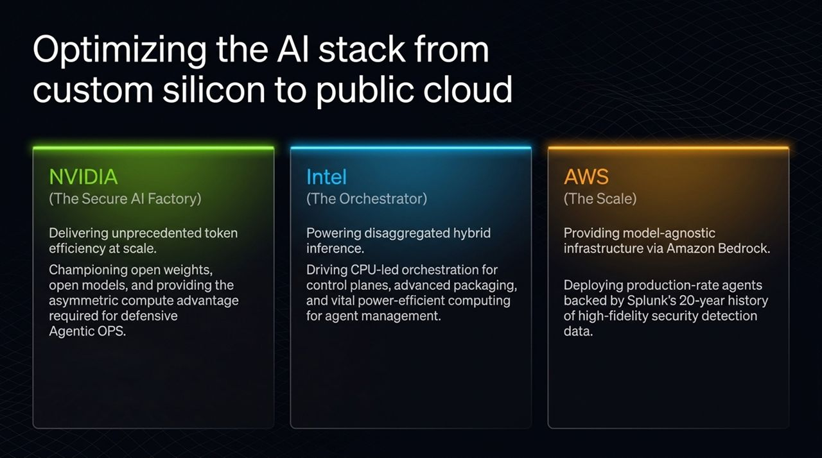
Notes:
Ecosystem Ecosystem Synergy: No single vendor solves AI infrastructure alone. We work closely with industry leaders across every tier:
NVIDIA (The Secure AI Factory): Partnering on high-throughput GPU systems, token efficiency, and open-weight architectures necessary for heavy defensive Agentic Operations.
Intel (The Orchestrator): Powering disaggregated hybrid inference across CPUs and accelerators, driving control-plane orchestration, advanced packaging, and energy-efficient edge compute.
AWS (The Scale): Providing scalable cloud infrastructure via Amazon Bedrock. Combining cloud-scale deployment with Splunk's 20-year foundation of security detection data to run production-grade agents confidently.

Slide 12
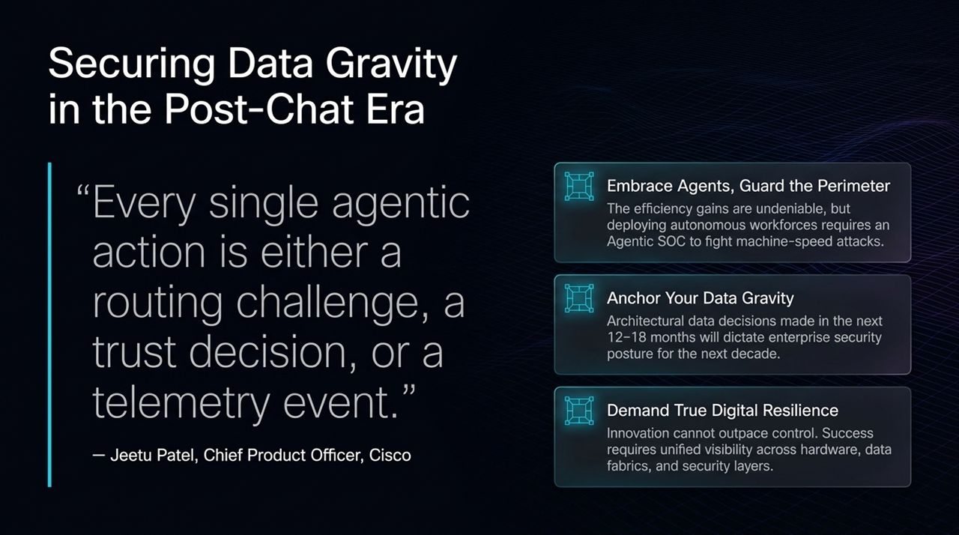
Notes:
A Quote from Jeetu Patel: "Every single agentic action is either a routing challenge, a trust decision, or a telemetry event."
Strategic Takeaways for Executive Leadership:
Embrace Agents, Guard the Perimeter: The productivity gains are too vast to ignore, but deploying autonomous agents without an Agentic SOC is an unmanageable risk.
Anchor Your Data Gravity: The architectural data choices you make over the next 12 to 18 months will dictate your enterprise security posture for the next decade.
Demand True Digital Resilience: Innovation must not outpace governance and control. True resilience requires unified visibility spanning hardware, network fabrics, and security tiers.

Slide 13
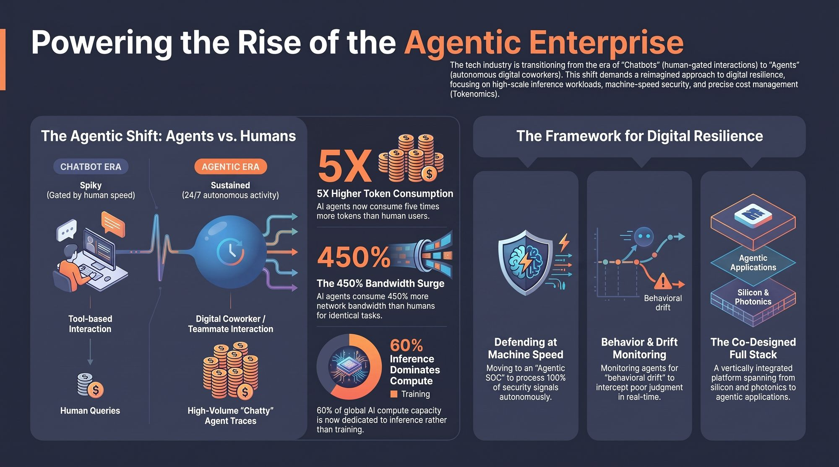
Notes:
Closing Synthesis: To wrap up our architectural strategy, let me leave you with this summary dashboard of the core realities we face:
The Shift: Moving from spiky, human-gated chatbot queries to continuous, 24/7 autonomous digital coworkers.
Infrastructure: Preparing for 5X higher token volumes and 450% greater network bandwidth requirements per task.
Compute Focus: Recognizing that 60% of compute capacity is now inference-bound.
Action Plan: Build a co-designed full stack—from silicon up to applications—equipped with an Agentic SOC, behavioral drift monitoring, and unified observability.
Final Thought: Thank you for your time. Let's open the floor to Q&A.
https://www.youtube.com/watch?v=-N6eBiOtPaM

